Slide 1
Project Updates
Ankita Roychoudhury
Murray Lab
11.13.2020

Slide 2
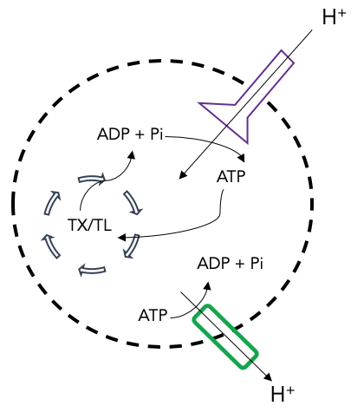
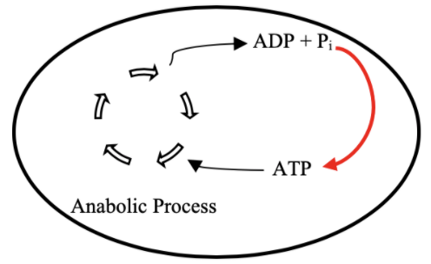

Goal: Cell-free Mitochondrial Mimics
Proposal: ATP Regeneration by ATP Synthase
TX/TL
Ankita Roychoudhury

Slide 3
Outline
Project Updates
Proposal
Future Plans

Slide 4
Project Updates

Slide 5
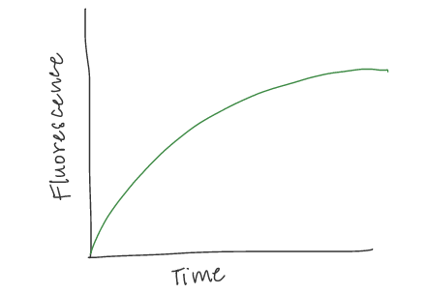
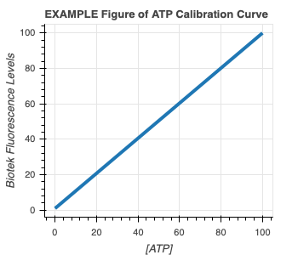
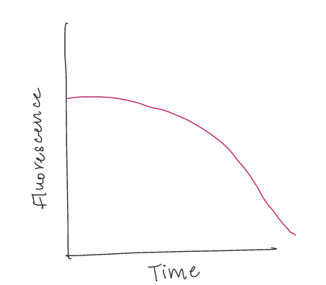

Experimental Plans
1) ATP Calibration Curve 2) Quantify GFP and ATP in bulk TX-TL with DNA
EXAMPLE GFP Curve
EXAMPLE ATP Curve

Slide 6
#2 cont.) Proposed Controls
In all cases, GFP and ATP will be measured
Exp # | deGFP DNA | Energy Buffer | TXTL Extract | Salt | Why?
1 | ✔️ | ✔️ | ✔️ |  | Positive Control
2 |  |  | ✔️ | ✔️ | Negative Control for background fluorescence
3 |  | ✔️ | ✔️ |  | Quantify ATP depletion due to metabolic leak
4 | ✔️ |  | ✔️ | ✔️ | How does the system perform without energy? How quickly does energy run out?
5 | ✔️ | ✔️ |  | ✔️ | How does the system perform with only energy?
Notes:
Talking with Manisha, pH is around 7 for buff and extract so no need for salt calibration. Will wait for her updated results though.

Slide 7
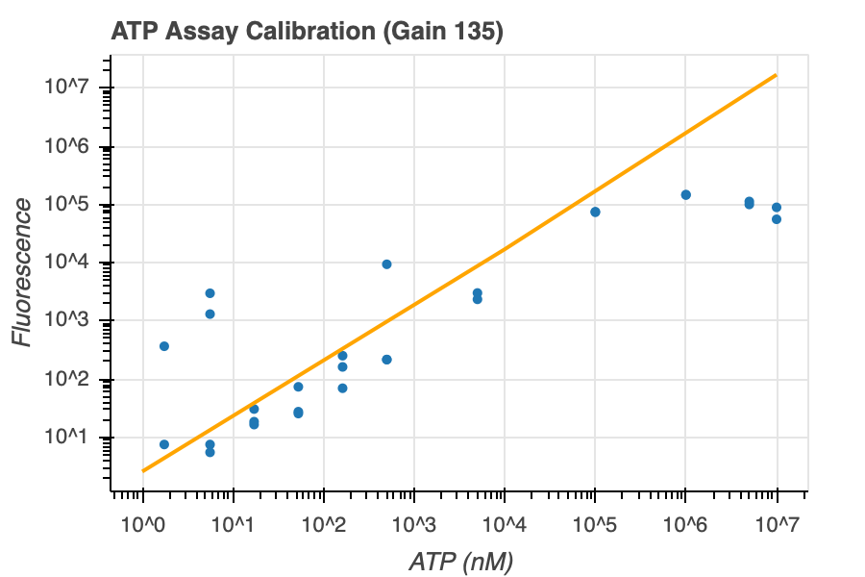
1) ATP Calibration Curve
Data from exp 9
Log Normalized Luminescence Data
Log
Figure 1
Slope = 1.2732601723574946,
Intercept = -1.6966496369015145
Notes:
maybe force intercept to 0

Slide 8
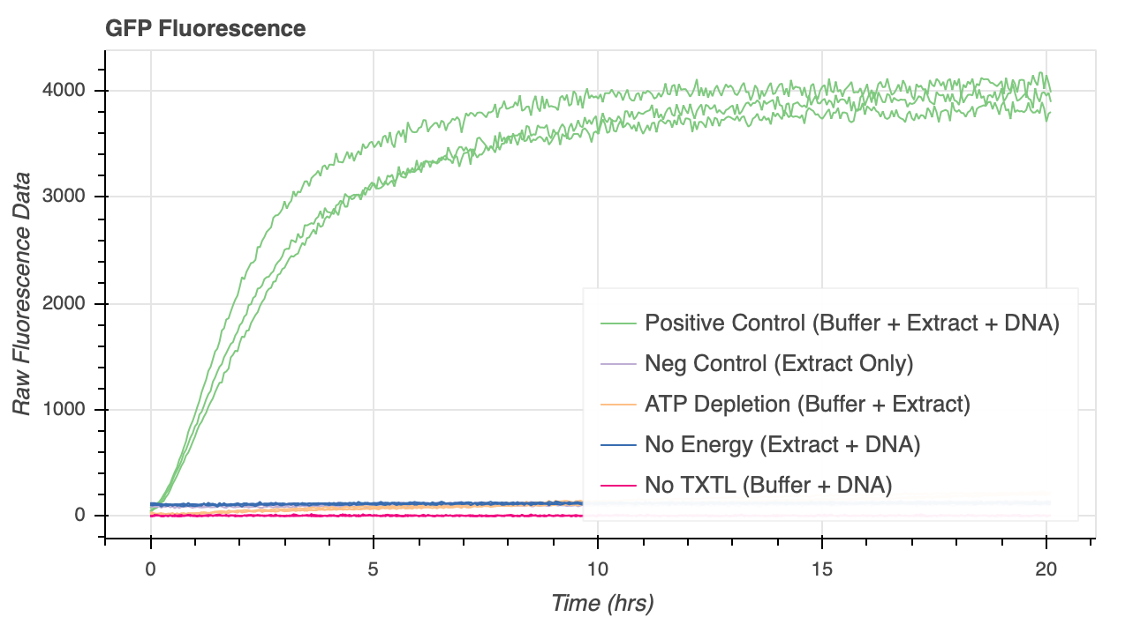
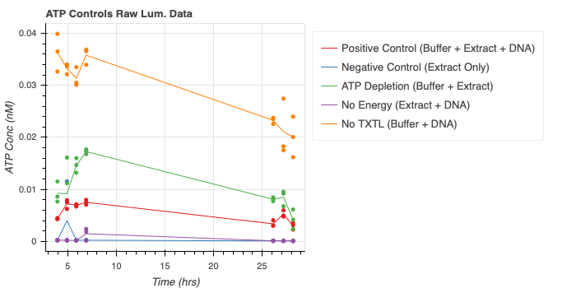
Data from exp 7
2) Quantify GFP and ATP in bulk TX-TL with DNA
EXAMPLE GFP Curve
Figure 2
Data from exp 10
EXAMPLE ATP Curve
Figure 3
Notes:
Worried about ATP Controls. ATP Conc is 1.5 mM at the beginning but positive control already goes to 0.05 nM. William guesses it’s an issue with ph, salt, buffer conditions used in calibration curve. He thinks salt and ph can strongly affect fluor. I agree but I had talked with Manisha about her pH experiments and she had seen around 7 for extract and buffer but that was very prelim data so I just added water instead of salt to calibrate.
luminosity measurement is lower in the TxTl reaction versus Buffer + DNA . My thought is that TxTL, globally, competes for the ATP with the luciferase, basically acting as a form of competative inhibition of the assay
way to test this hypothesis would be to mix Extract + ATP + Assay Reaction Mixture and Compare to pure ATP + Assay Reaction Mixture (both at the same salt concetration and pH). If for the same amount of ATP you get different readout, that is a sign that extract is interfering with the assay.

Slide 9
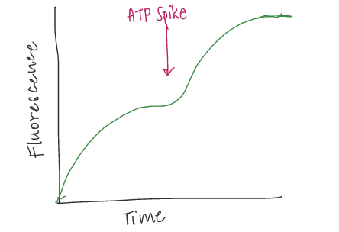
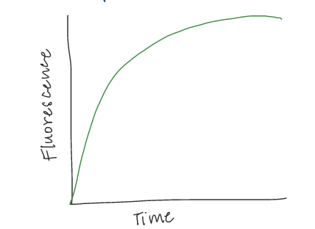
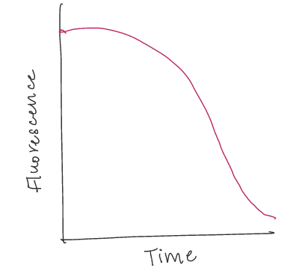
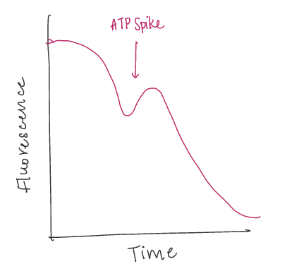
3) Add more reagents at start 4) Add more reagents in the middle
PREDICTED GFP Curve
EXAMPLE GFP Curve
PREDICTED GFP Curve
EXAMPLE ATP Curve
PREDICTED ATP Curve
PREDICTED ATP Curve
Hypothesis: Proportionally more protein production with more initial ATP
Hypothesis: Can revive protein production with ATP spike

Slide 10
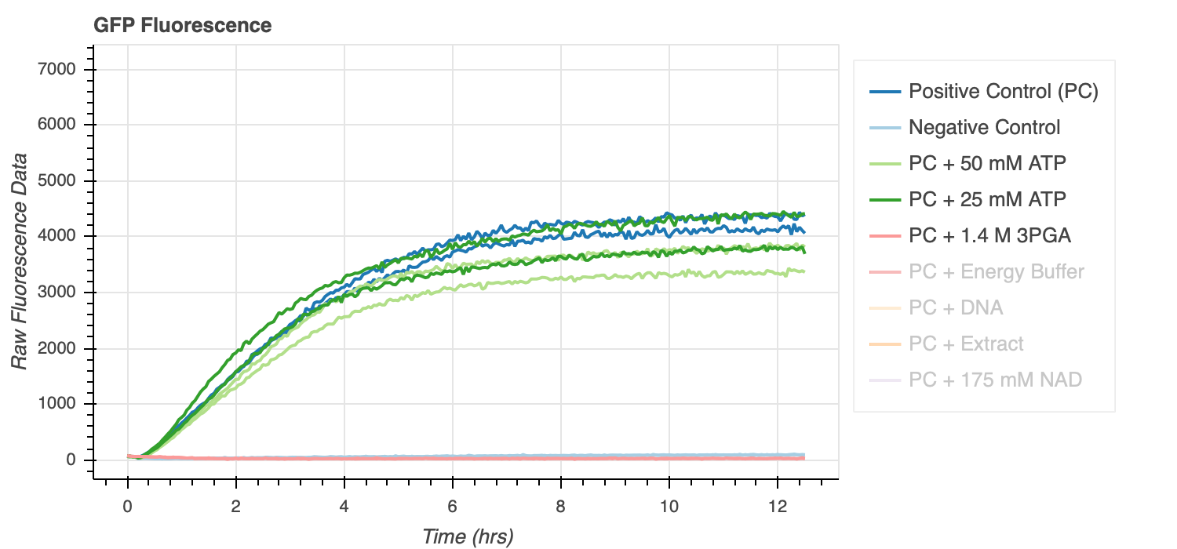
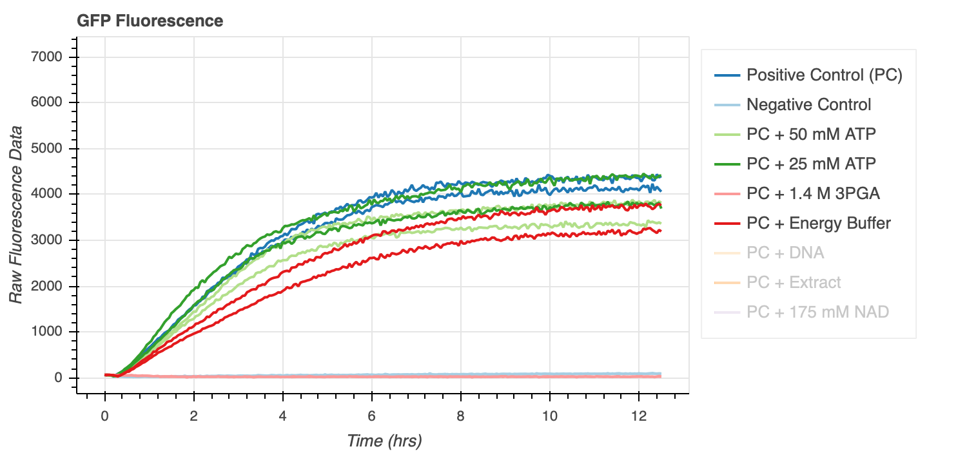
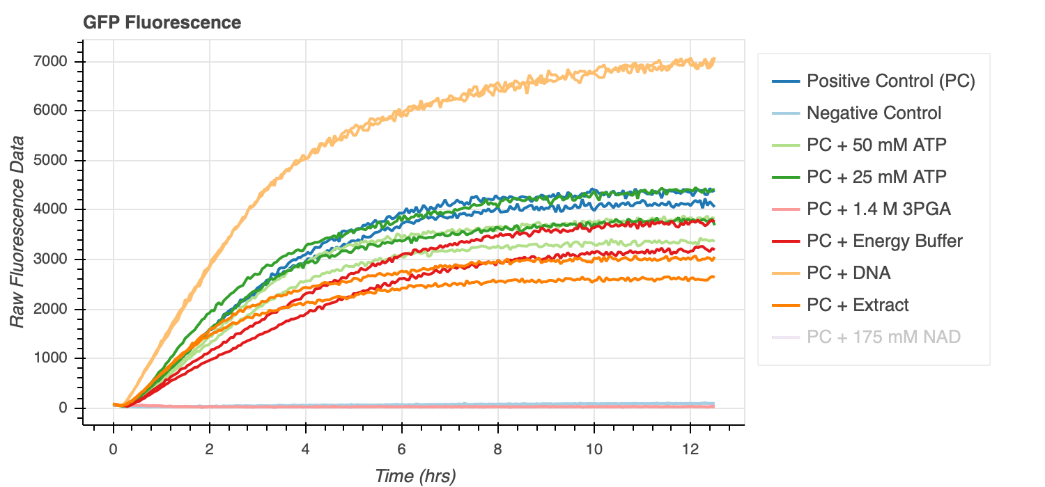
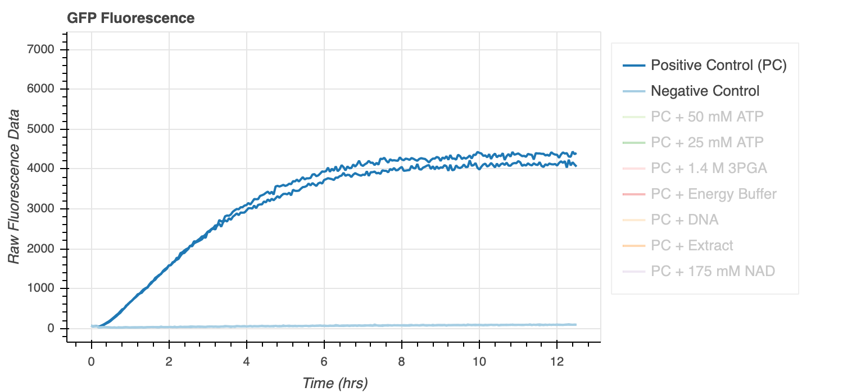
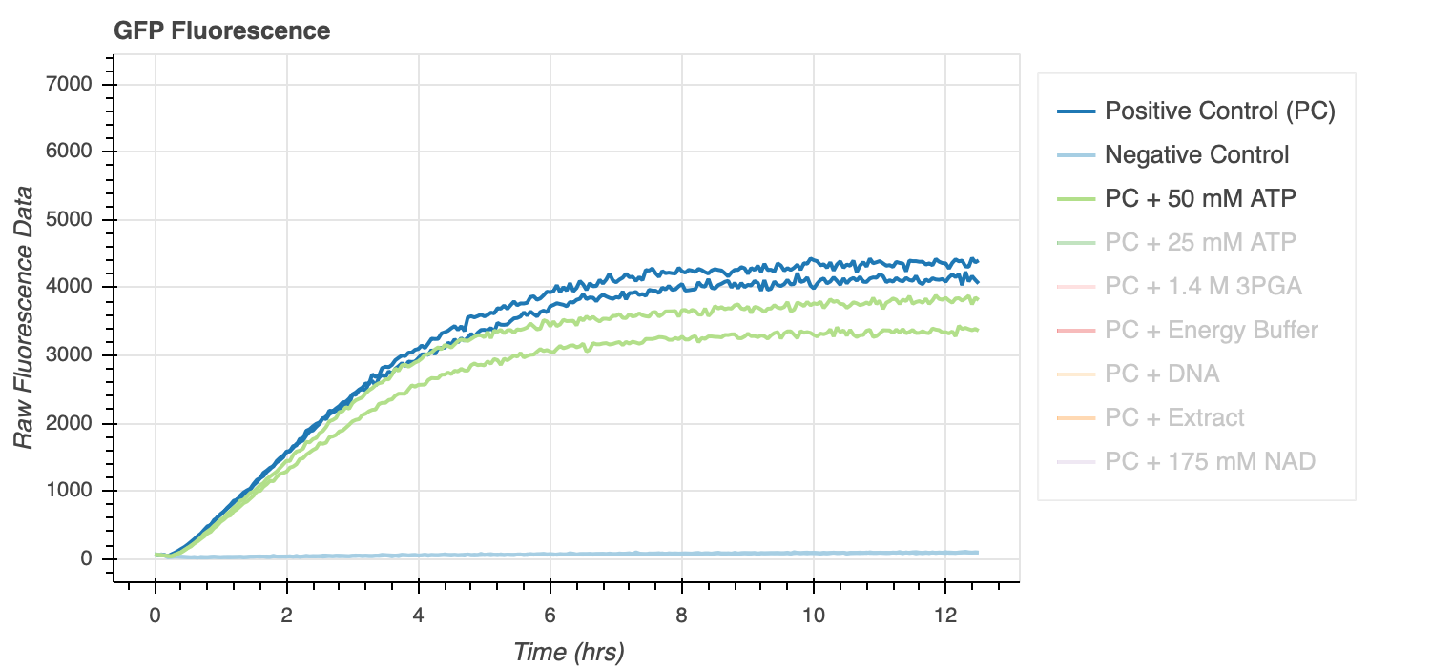
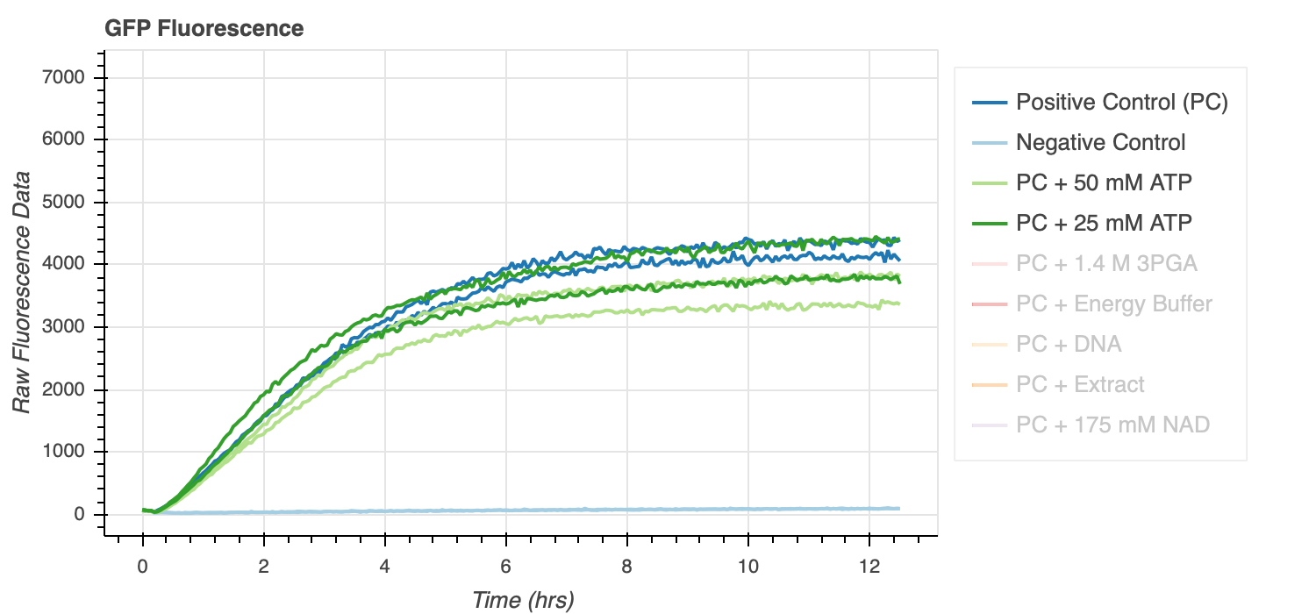
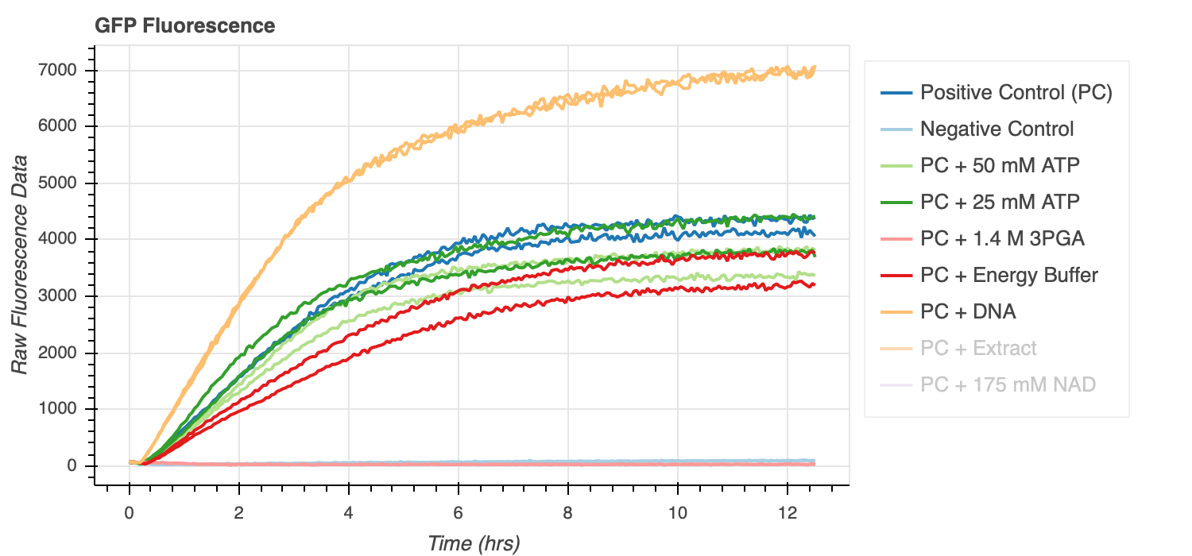
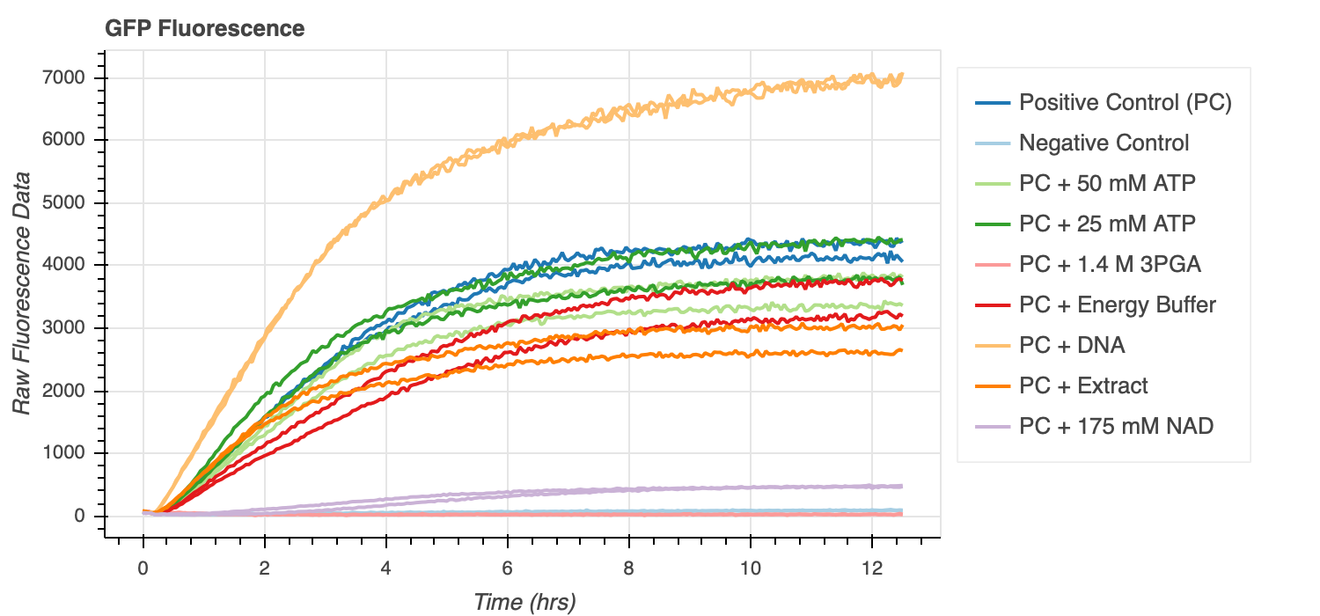
3) Add more reagents at start
EXAMPLE GFP Curve
PREDICTED GFP Curve
Data from exp 13
EXAMPLE ATP Curve
PREDICTED ATP Curve
Figure 4
Hypothesis: Proportionally more protein production with more initial ATP
Notes:
hypo here is that there's toxicitiy effects. when i add too much reagents, thre may be Pi buildup or drastic pH changes

Slide 11
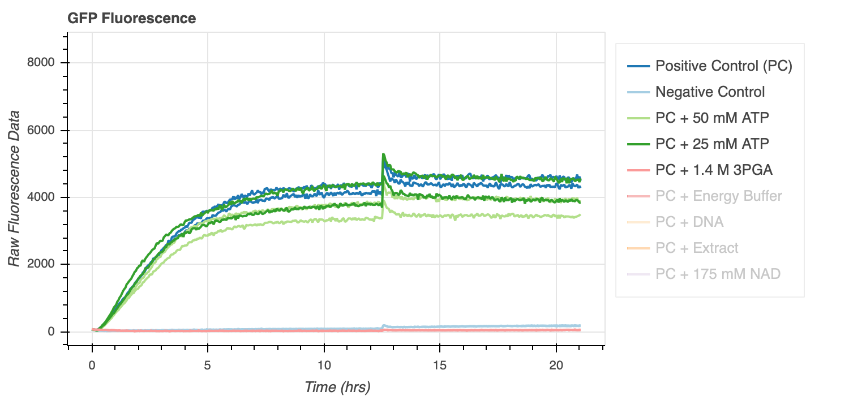
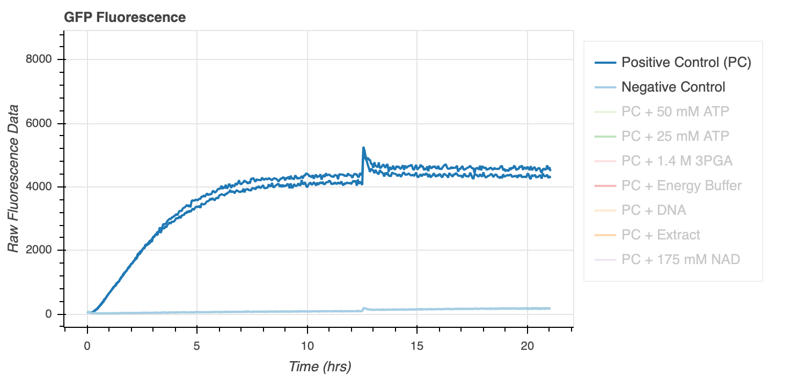
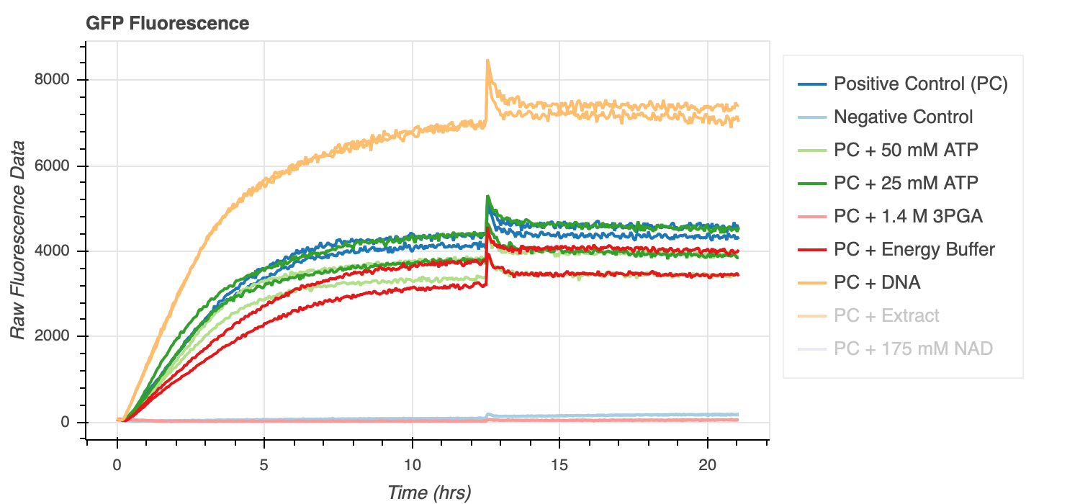
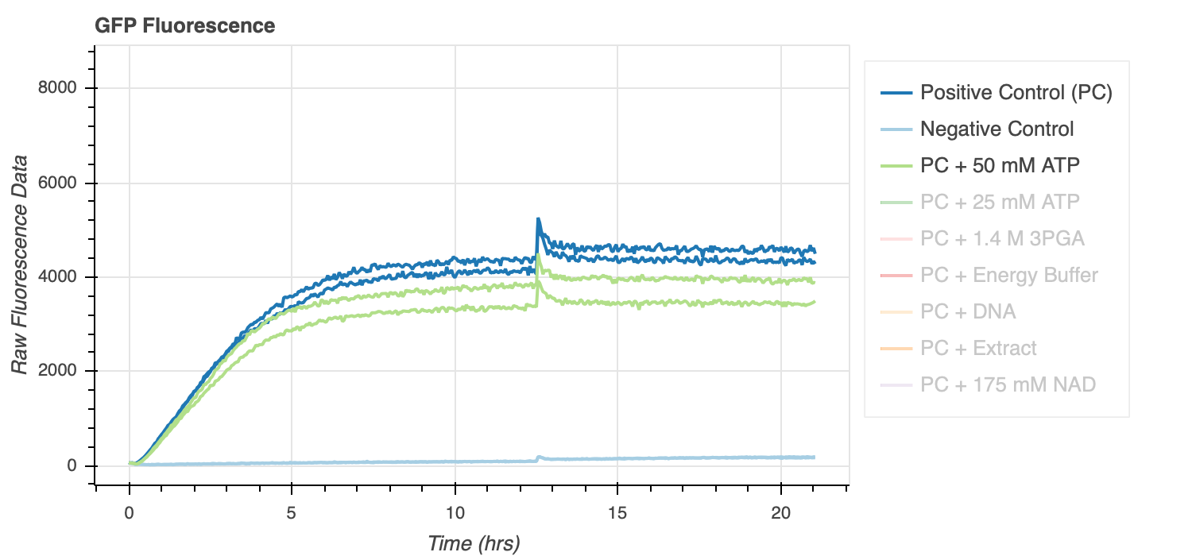
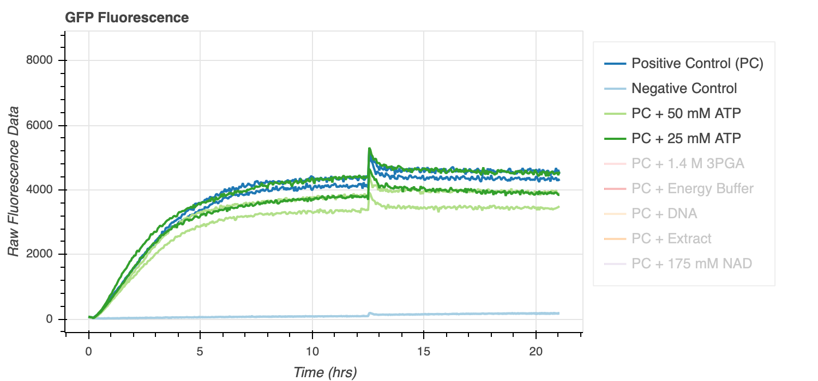
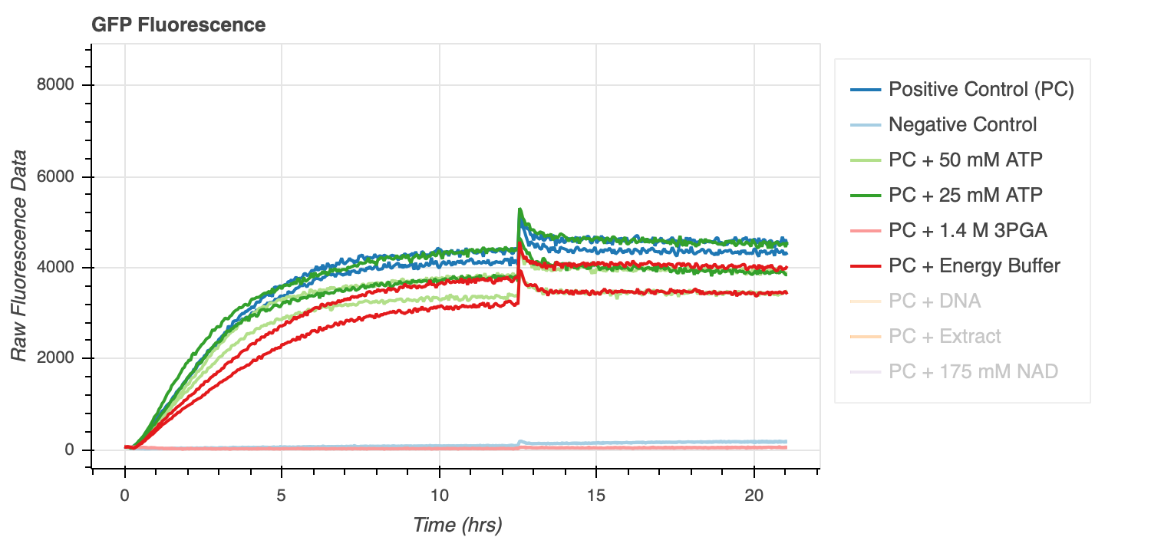
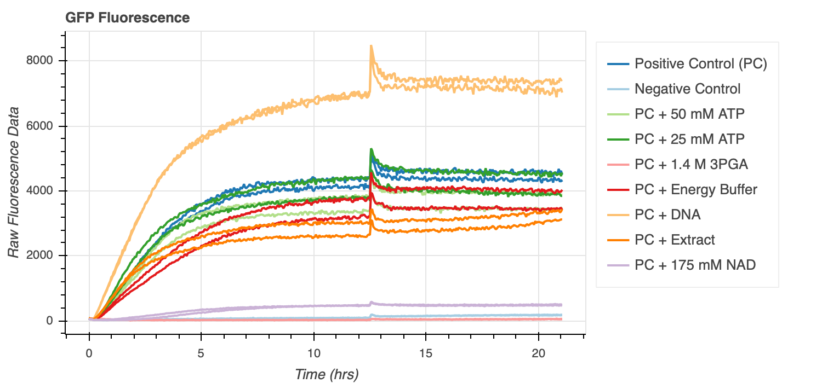
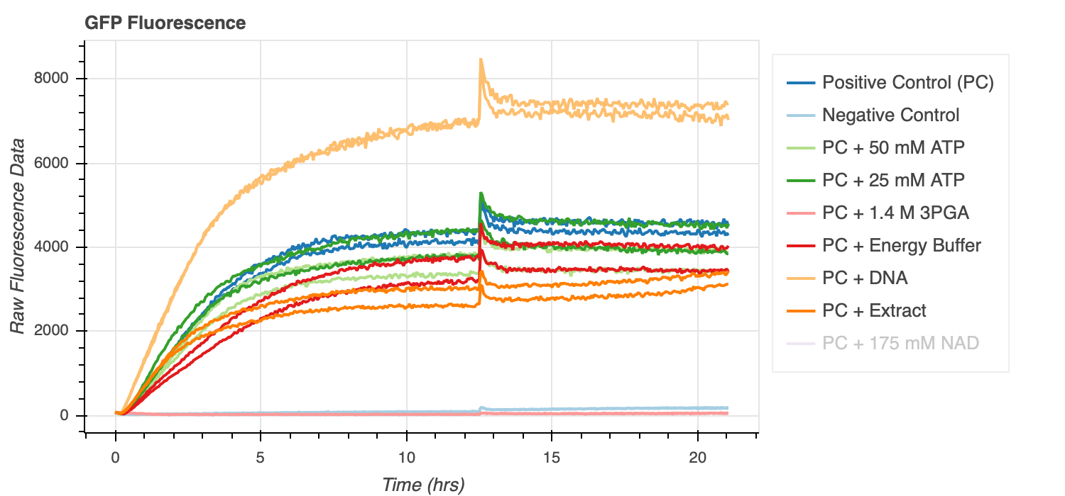
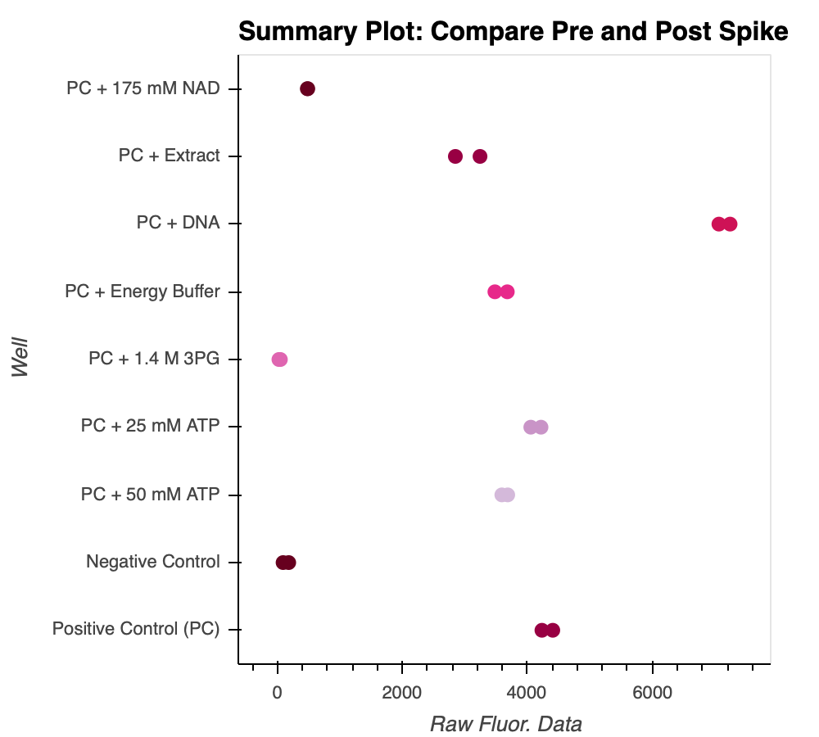
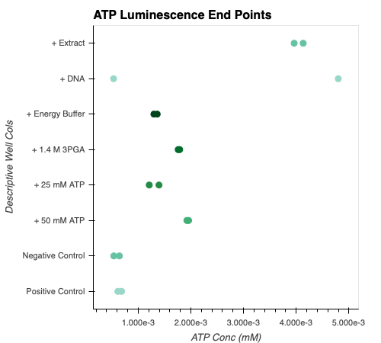
4) Add more reagents in the middle → Add more reagents in beg. + middle
PREDICTED GFP Curve
Data from exp 13
Figure 5
PREDICTED ATP Curve
Data from exp 13
+ 175 mM NAD sample ATP end point not measured by accident
Hypothesis: Can revive protein production with ATP spike
Figure 6
Notes:
Not exactly what I had said I would do. Last time I said I’d do more reagents in middle – time and reagent constraint so I did the spike experiments on the same data in the previous. So there is + 50 mM atp in the beg and at time 12, so not necesarilly indicative of what I wanted to see because it’s possible I saturated it already.
Anyways, for this data, we see that there’s not much improvement except in the extract.
In future, I will repeat this graph and only spike in some at 5-7 hours instead of 12 to see if I can do something before steady state reached.
Talking with Manisha and zoila, they think that toxicitiy is playing a role here. Maybe Pi accumulation or drastic change in pH that isn’t compatible with reactions. So I may try to use an ADP assay. Also, theoretically the atp synthase would fix this. I think maybe the limiting factor isn’t necesarilly ATP but toxicity. Either way, worth pursuing this project (since I had thought this to be almost a requirement to moving forward).

Slide 12
After that… This Week
5) Characterize GFP and ATP with TXTL Extract, Buffer, & DNA in vesicles
6) Add ATP Synthase, Proton Pump, and Test!
Repeat Spike Exp. correctly
Spike at hr 5
Add control well
Take ADP measurements
Repeat ATP Control Exp.
Confer w. Manisha and William about pH concerns
Use Energy Free Buffer to Calibrate ATP Conc.?

Slide 13
Random Proposal
Not ready...in the works
Notes:
I’ve been thinking a lot about combining biology and DNA with electronics ..
Not developed
Might send something, might realize it’s useless
Not something I want to submit to anyone..just something I want to get your opinion on if you have time
VERY low priority
Just wanted to make u aware

Slide 14
Future Plans
December research access?
Third term off – get hired?
GRE opinion
Notes:
3.4 GPA
Verbal – 158 / 170 (79th percentile)
Quan – 165/170 (85th percentile)
Analy – 5/6 (92nd percentile)

